Slide 1
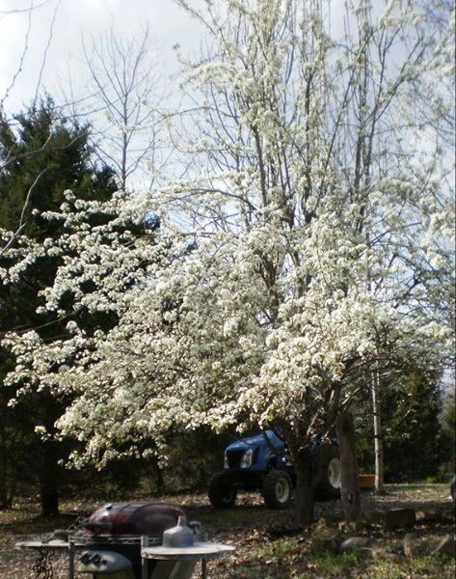
This is garden number one and this paragraph tells something educational and something interesting about this garden.

Slide 2
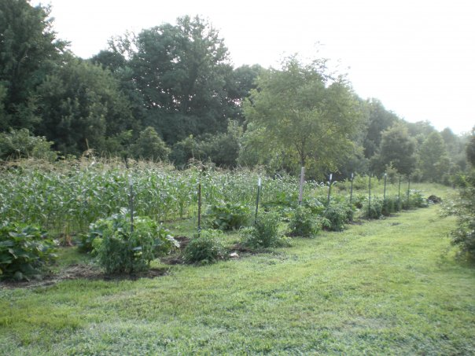
This is garden number two and this paragraph tells something educational and something interesting about this garden.
This is some more text.

Slide 3
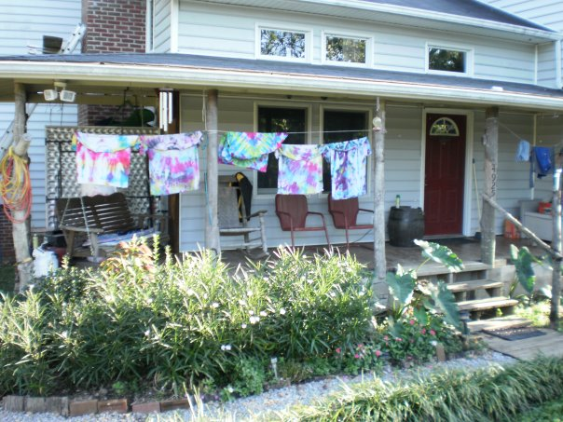
This is garden number three and this paragraph tells something educational and something interesting about this garden.
This is some more text.

